Slide 1
Software Quality Assurance
Er. Bipin Thapa

Slide 2
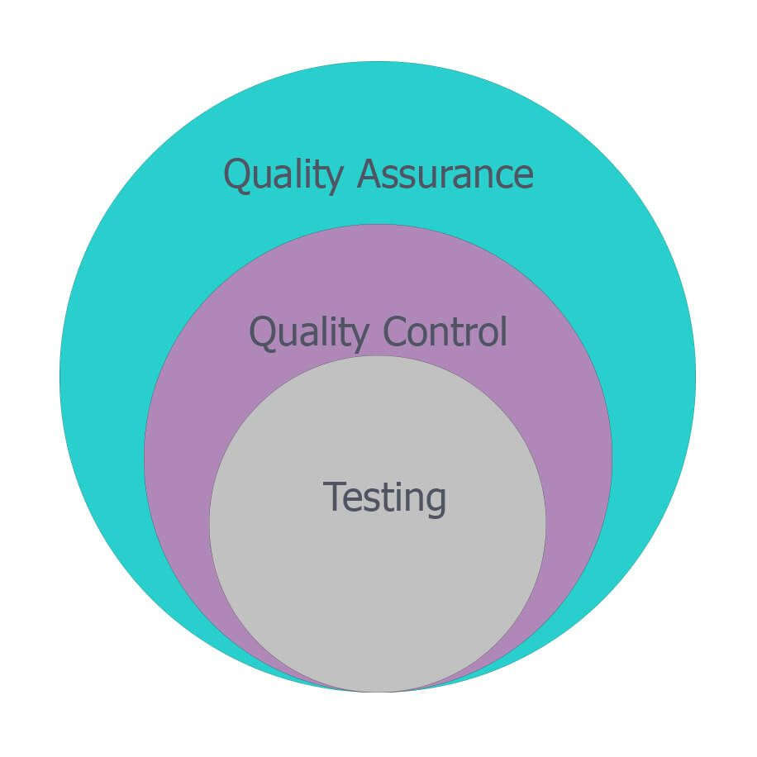
Testing is the sub-set of Quality Control and Quality Control is sub-set of Quality Assurance

Slide 3

Quality assurance
It is the proactive approach of quality management which focuses on preventing the defects at process level.
It is a process Oriented.
Prevention of Defect

Slide 4

Quality Control
It is the reactive approach of quality management which focuses on finding the defects at the product itself.
It is a Product Oriented.
Defect Detection

Slide 5

Testing
It includes activities that ensure the identification of bugs/error/defects in a software.s
It executes the software under several positive and negative conditions and checks for its compliance, functionality, and performance

Slide 6
Some of the Main Objective Testing
Identification of Bugs and defects
Once the developer finishes coding, the tester starts testing. During testing, QA validates each module under various conditions.
Quality Product
The main aim of testing is to maintain the quality of the product.
Justification with Requirement
During testing, the QA team validates whether the application is following the SRS (System Requirement Specification) document or not.
Offers Confidence
Testing team constantly checks the features of the software. It must fulfill the business demand and drives confidence.
Enhances Growth
A quality delivery increases the potential of a business. And we all know quality comes through testing only.

Slide 7
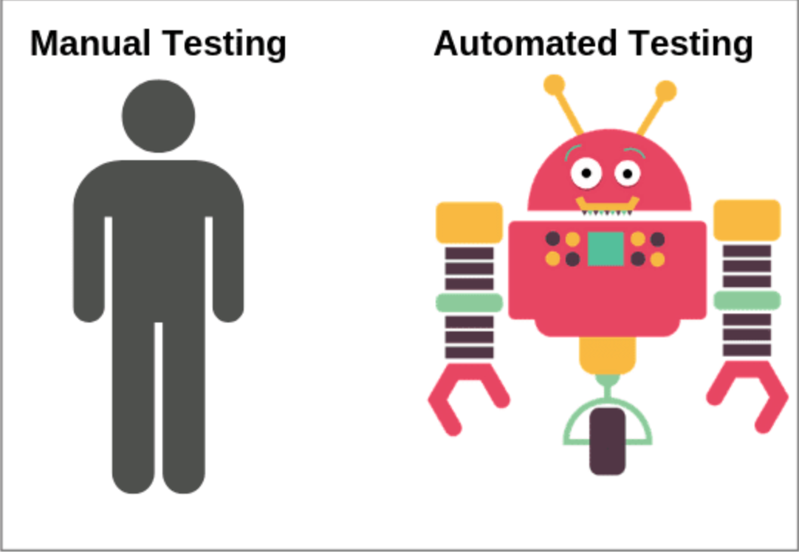
Type of Software testing
We have various types of testing available in the market, which are used to test the application or the software.
Manual Testing
Automation Testing

Slide 8
Some of the causes of Software Errors
Faulty requirements definition
Client-developer communication failures
Deliberate deviations from software requirements
Logical design errors
Coding errors
Non-compliance with documentation and coding instructions
Shortcomings of the testing process
User interface and procedure errors
Documentation errors

Slide 9

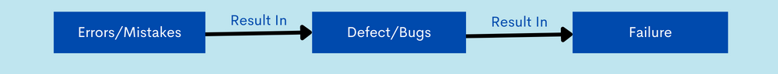
Error, Defect/Bug, Failure

Slide 10
Error
An error is a mistake made by a developer in the code. Its main causes are:
Negligence: Carelessness often leads to errors
Miscommunication: An unclear feature specification or its improper interpretation by developers could lead to slips.
Inexperience: Inexperienced developers often miss out on essential details, leading to faults down the line.
Complexity: Intricate algorithms can cause developers to make mistakes in their coding logic.

Slide 11
Defect & Bug
A system is said to have a defect, when its expected and actual behavior differ. A defect, when found by a tester or end-user, is called a bug. Its main causes are:
Missing test cases
Test cases not executed by the tester
Improper execution of test cases
Code changed after testing

Slide 12
Failure
When one or more bugs cause a significant loss of functionality, a failure is said to have occurred.
For example, in a bank application if the Amount Transfer module is not working for end-users when the end-user tries to transfer money, submit button is not working. Hence, this is a failure.

Slide 13
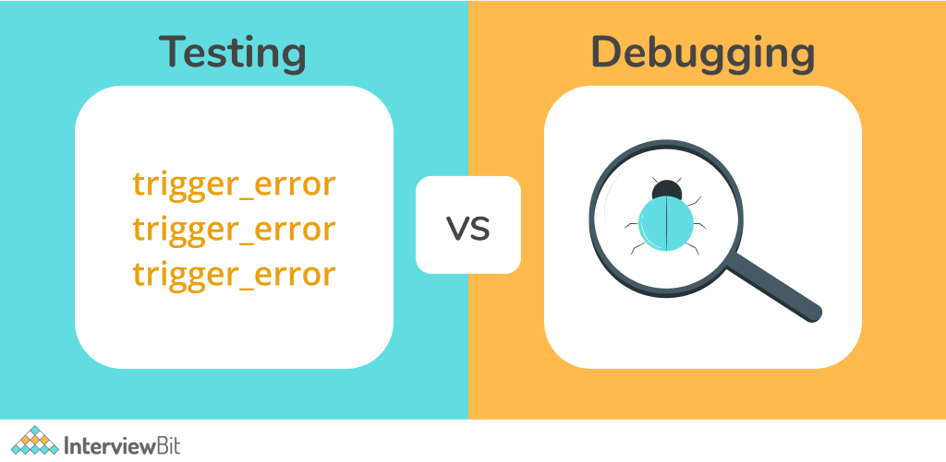

Slide 14
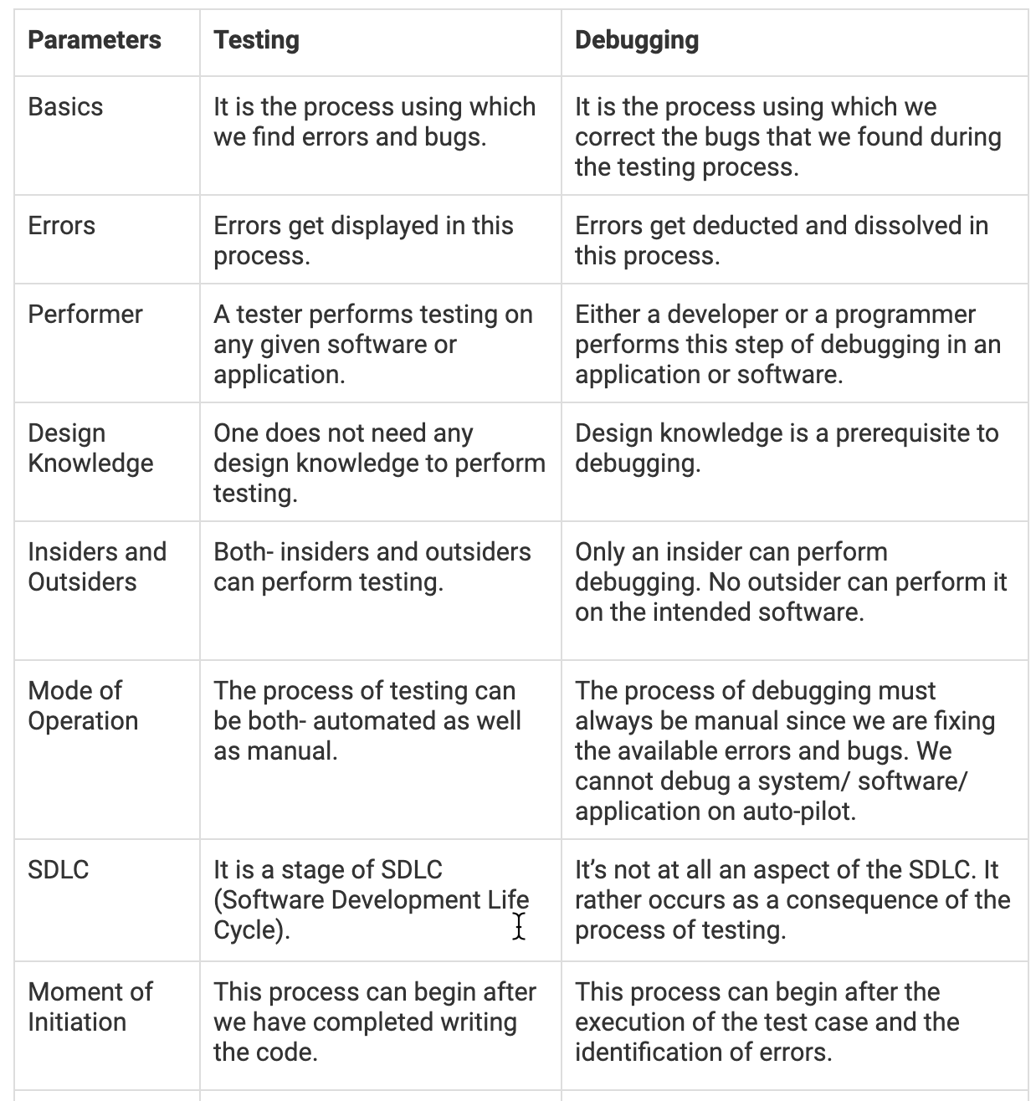
Testing and Debugging

Slide 15
Advantages of Software Testing
Helps in saving money
Security
Quality of the product
Satisfaction of the customer
Enhancing the development process
Determining the performance of the software
Maintains Great User Experience

